Slide 1
LiveBook Project
Presented by
Osaide Omawumi Divine
Team Stealth
Datalab Abuja.

Slide 2
INTRODUCTION
I used the actions2load Database provided to us, MySQL to interact and perfom queries on the dataset and PowerBi to design a User Interactions Dashboard and also for Forcasting purpose . The Dataset contained 5 columns which includes account id –showing the unique users, Event Time – recording the entry time is seconds, Event-type – shows the type of event that occurred, it consisted of 25 different events, Product id and an Aditional data column.
The Dashboard gives a comprehensive visual representation of how users interacted with the LiveBook, highligting events porpularity and trends. It shows an event occurrence forcasting, providing a detailed data driven projection of the event occurrence trend by time of day down to the very second for the next 24hours.
Further improvements can be made by using more advance analytics and machine learning models to give a more precise and clearer picture as to the prediction of event occurrence.

Slide 3
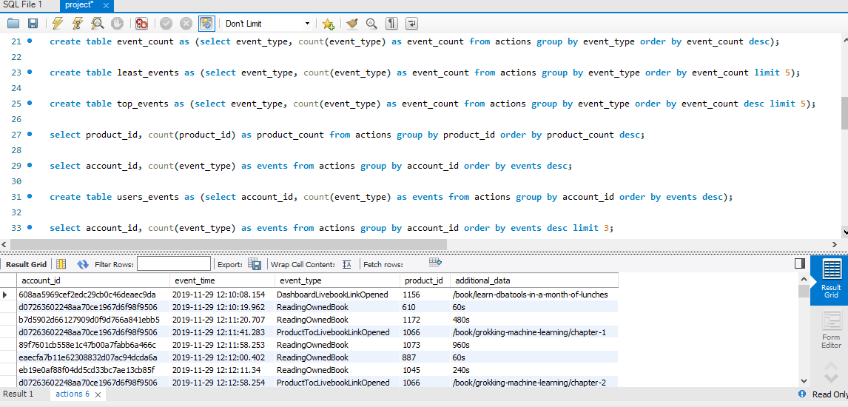
Dataset Opened and being viewed and queries on MYSQL Workbench

Slide 4
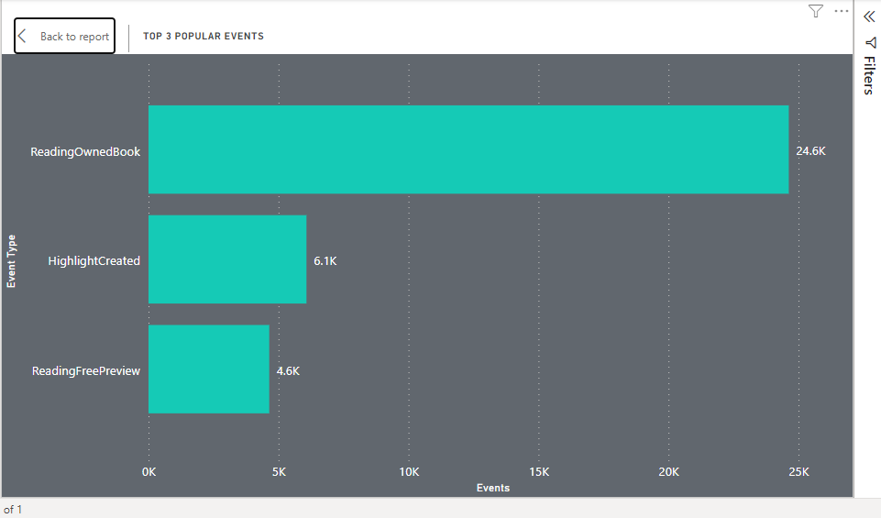
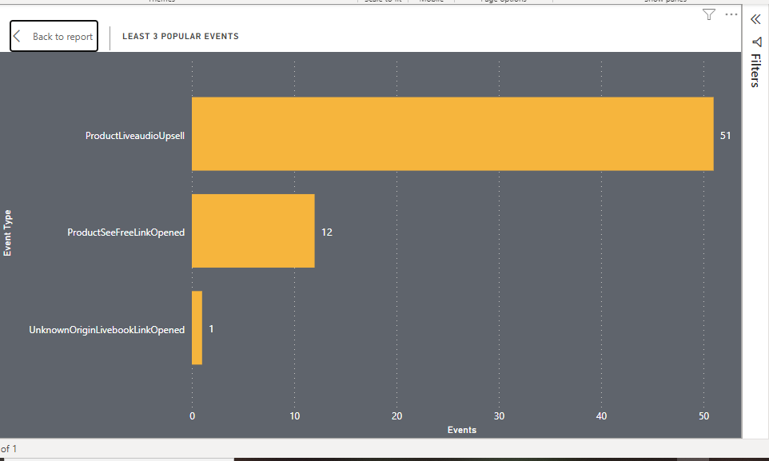
Top 3 Events
This is a bar chart shows event occurrence, it gives a clear indication of events porpularity, highlighting the top 3 porpular event and the least 3 events based on porpularity among the users. Analysis showed that there was 25 different event types, with a little over 65k hits spread across these 25 event types. The top 3 events consist of ReadingOwnedBook, which had almost 25k hits, HighlightCreated and ReadingFreePreview, while the 3 events at the buttom end includes ProductLiveaudioUpsell, ProductSeeFreeLinkOpened and UnknownOriginLivebookLinkOpened which had just a single hit.
Least 3 Events

Slide 5
USER ACTIVITIES
A total of 6251 different users where recorded, these users were categorized into 4 groups based on the amount of interactions they had with the LiveBook regardless of the type of event carried out. The categories include;
Slightly Active – users having between 1 – 10 entries
Moderately Active – users having between 11 – 50 entries
Active – users with 51 – 200 entries
Very Active – users with 201 – 1600 entries

Slide 6
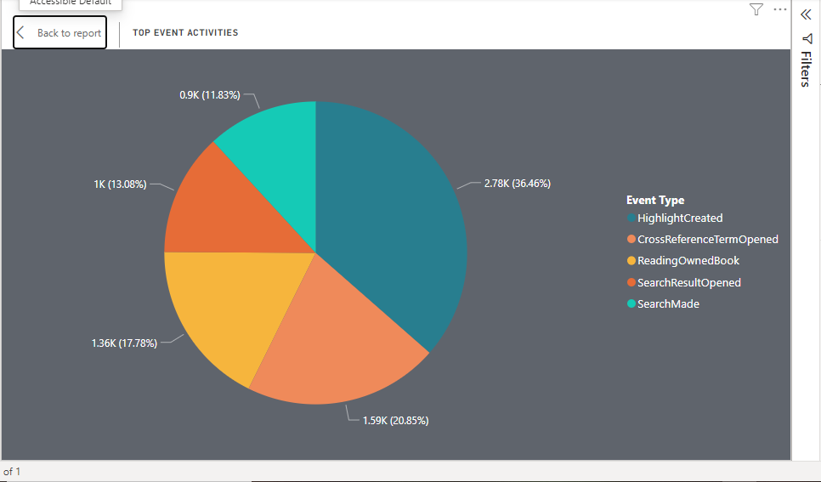
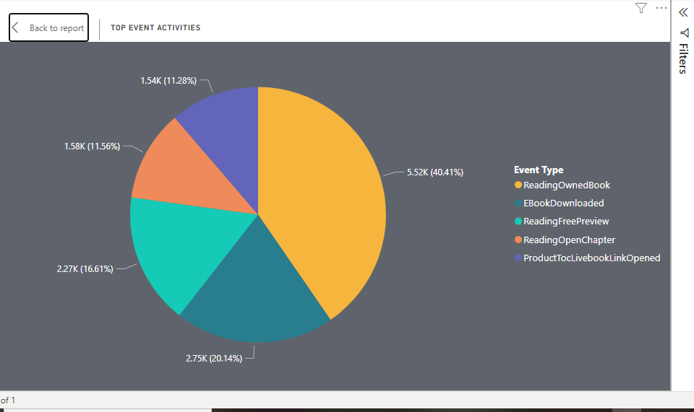
Chart-1
Chart-2
This pie chart shows the event occurrence in percentage for the Very Active users, analysis showed that they recorded the lowest percentage recorded in reading among the 4 categories, despite having the highest amonts of entries. They spent a disturbinly low amount of time actually reading anything as they spent a significant amount of time seraching for books and opening these searches, in a way trying to decide what to read.
This shows the distribution of event occurrence in the Slightly Active group, while just having very few entries, they made the most of the LiveBook fully utilizing it, as they spent over 80% of their entries actually reading books and downloading ebooks to read, as opposed to the Very Active group which barely recorded 20% or reading anything.

Slide 7
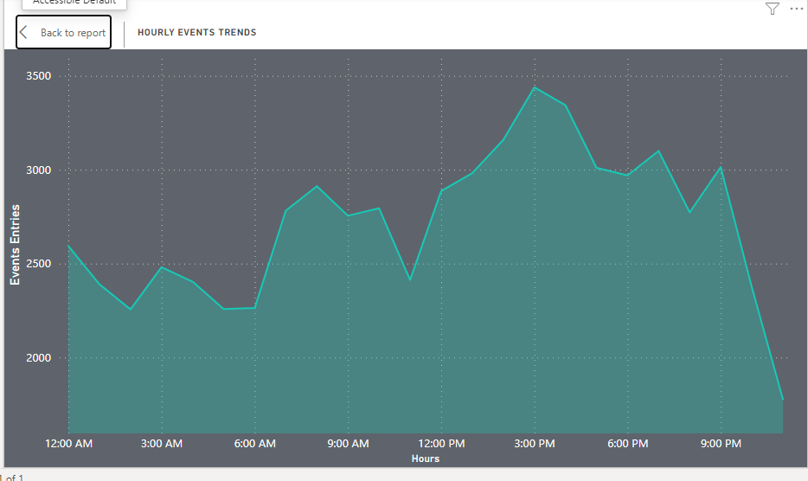
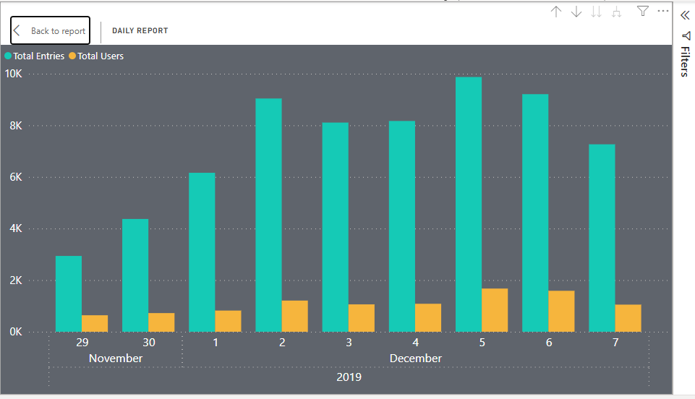
This displays a line chart showing total events occuring per hour over a 24 hours period. The chart is generated by grouping the event time into a 24 hours period and taking a count of the events as they occur within the hour. The chart shows that the total events flutuated during the early hours of the morning. There was significant and steady increase majorly noticed at 2 points on the chart, first at 6:00am, before being derailed at the 8:00am where there was a slight decrease but then the upward trend continued at 11:00am reaching its hightest point at 3:00pm recording almost 3500 event entries, before taking a significantly downward trend marking an all time low point at the 11:00pm mark. The trend over time is useful for forecasting & making business decisions.
This bar chat showings the Total Entries made on the livebook per day along side the Total Users for each day. ﻿Total Entries (147.28% increase) and Total Users (64.48% increase) both trended up between Friday, November 29, 2019 and Saturday, December 7, 2019.﻿﻿ ﻿﻿ ﻿﻿Across all metrics, Total Entries had the most interesting recent trend and started trending up on Friday, November 29, 2019, rising by 147.28% (4327) in 8 days.﻿﻿Total Entries jumped from 2938 to 7265 during its steepest incline between Friday, November 29, 2019 and Saturday, December 7, 2019.﻿﻿ ﻿﻿ ﻿

Slide 8
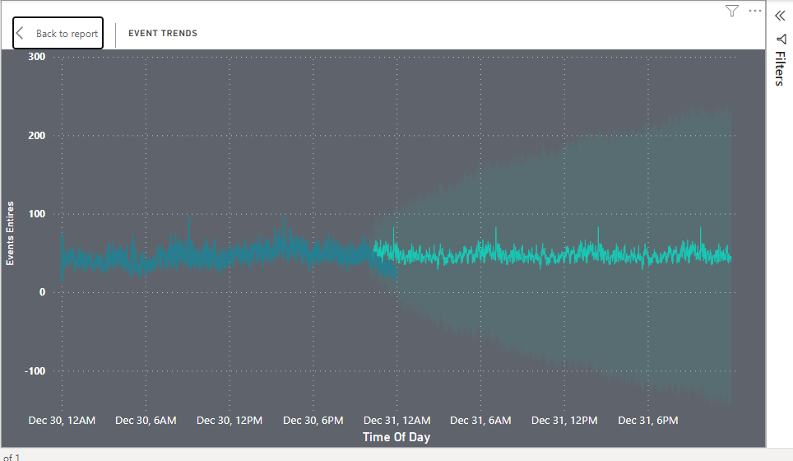
This shows a linechart, which displays the event occuring at each time of the day down to the second for a 24hours period, analysis shows a fluctuation in event occurrence with 2 noticible spikes first between 7am – 9am and again between 1pm – 3pm.
FORECASTING
With the help of power bi, futher analysis was made to predict the trend of event occurrence over the next 24hours period. for this analysis, the last 2 hours of the actual data was ignore so we can compare how the forecast compares to the actual data. The forecasted data followed a fairly similar pattern to the actual data with fluctuations of event occurrence across the 24hours period, with 3 main upwards spikes first at around 7am, then at 2pm and finally at 9pm.
This chart is useful for giving a clear forecast of event trends while comparing it to the trend of the actual data, to know how similar or dissimilar they are and determining the level of accuracy.

Slide 9
BUSINESS INSIGHT
A more targeted and direct book recommendation system should be added to the LiveBook to aid users in the selection and picking a book of their preference to read, this will help both the users most especially the very active users who spend a lot of time searching for what they like(as they might find it difficult to decide on a book on their own) to do more reading and downloading of ebooks, as when they open the live book a list of book suggestions will be provided for them and then they can pick any of their liking to read or download. This will help reduce the amount of time spent on searching, turning it into time reading or downloading books to read later, there by improving the quality of the LiveBook experience for every user.

Slide 10
THE END

